Slide 1
Capstone project: Meezy cutz
Kierra McCallum, Ayman Ibrahim, Zack Munford

Slide 2
Purpose
Allow barber to manage and communicate with customers
Allow business to become more prominent by getting the company on the internet.
Allow better time management via appointment system
Display photo catalog of previous work done by Meezy Cutz.
Show location of shop and driving directions to customers who are not sure of the location
Allow customers to ask questions or concerns about the website or the business via email system.
Achieve more business via social media.

Slide 3
Key Functional Requirements
Create Account
Customer schedule appointment
Verify user
Admin login
Manage user accounts

Slide 4
Main User Interfaces
Gallery Interface
Google Maps Interface
Email System
Main Page

Slide 5
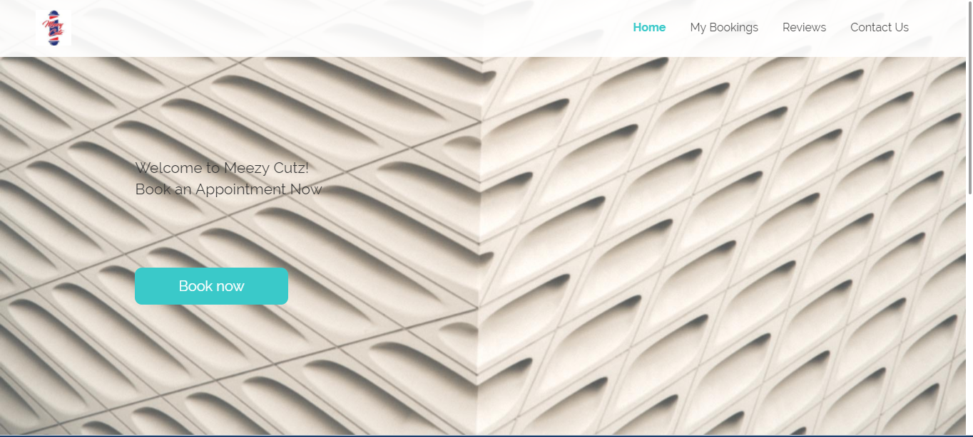
Appointment System

Slide 6
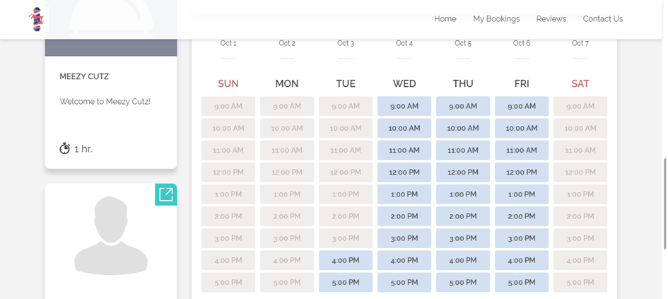
Appointment System

Slide 7
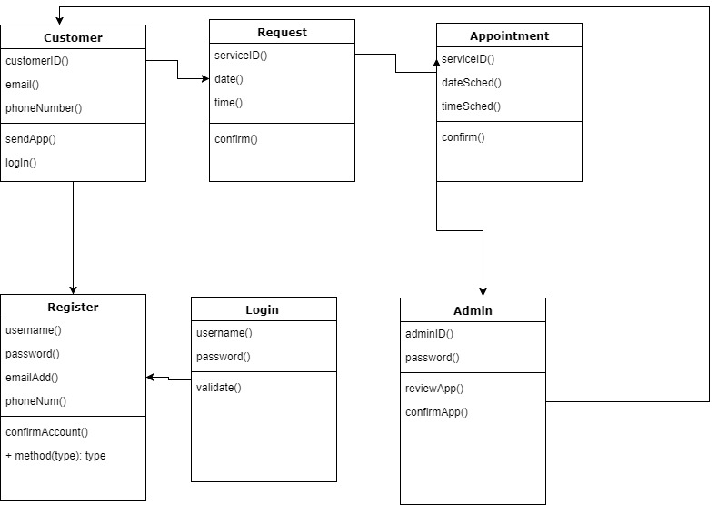
Class Diagram

Slide 8
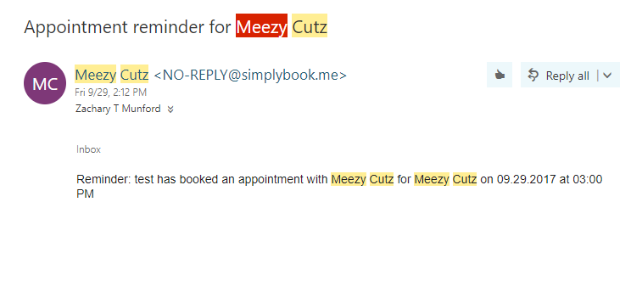
Test Cases

Slide 9
The End

